Slide 1

REAL ESTATE PRICE PREDICTION
Subject: Data 606(Capstone Project)
Professor: Chaojie Wang
Presentor: NAVEEN DONTHULA

Slide 2
PROBLEM STATEMENT
The aim of this project is to develop a reliable real estate price prediction model that can accurately estimate property prices based on various features. The dataset contains historical data of real estate properties, including information such as location, size, number of bedrooms, bathrooms, and other relevant attributes. You are required to build a linear regression model using the Scikit-learn (sklearn) library in Python and implement data science principles like outlier removal and feature engineering to improve the model's predictive performance.

Slide 3
Objective
Our aim is to predict the price of houses located in a area by using the regression models.
Aim is to accurate are the real estate price predictions provided by the developed model compared to the actual market prices, and what is the overall performance evaluation of the model in terms of mean squared error or R-squared value.
The real estate price prediction website handle a high volume of concurrent user requests, and what is the average response time for serving predictions.
How efficiently does the model perform with dimensionality reduction techniques, balancing predictive power and computational complexity?
Used hyperparameter tuning using GridSearchCV in improving the model's performance and capable enough to use in the real estate.

Slide 4
SOLUTION
The research interests in this project include advanced machine learning models for real estate price prediction, novel feature engineering techniques, deep learning algorithms for market trend analysis, and the impact of external factors on real estate prices.
The expected outcomes of this research are improved accuracy in predicting real estate prices, enhanced understanding of factors influencing prices, automated valuation models for financial institutions, and comprehensive market analysis tools for real estate professionals and policymakers.
These research interests aim to drive informed decision-making, facilitate strategic investments, streamline property appraisal processes, and provide valuable insights into the dynamics of real estate markets.

Slide 5
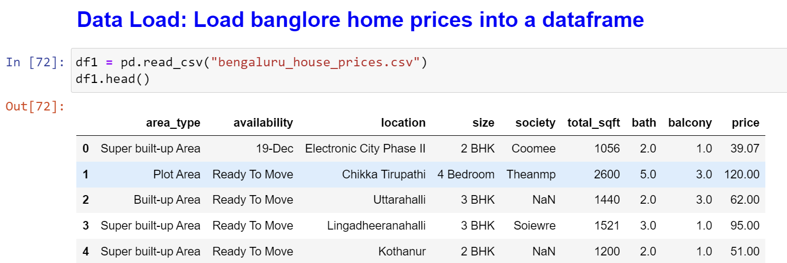
DATASET
Dataset has 13,320 rows and 9 columns. This dataset is from Kaggle created by amitabhajoy.

Slide 6
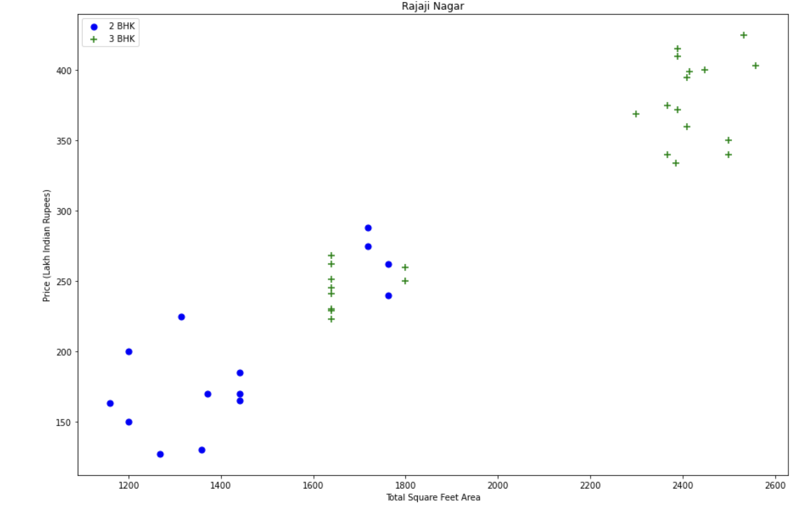
Let's check if for a given location how does the 2 BHK and 3 BHK property prices look like

Slide 7
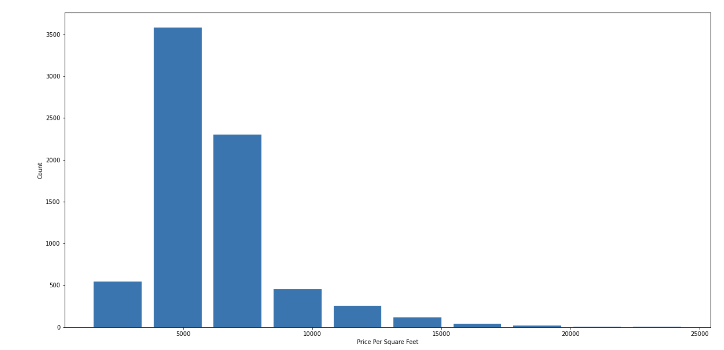
This Graph shows the Price Per Square feet value.

Slide 8
Model Usage
Implemented K-fold cross-validation and Grid Search CV approach enables the identification of the most suitable regression model and hyperparameters for real estate price prediction.
It serves as a valuable tool in the data scientist's toolkit, providing a systematic and data-driven approach to model selection and hyperparameter tuning, ultimately contributing to more accurate and reliable predictions.

Slide 9
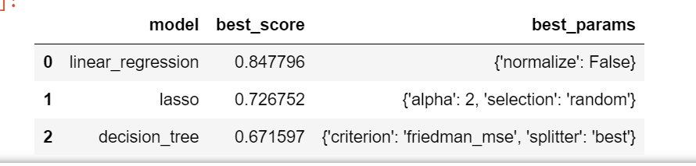
Accuracy Scores of Different Models.
Based on the above results. we can say that Linear Regression gives the best score. Hence, we will use that for the Prediction of House Prices.

Slide 10
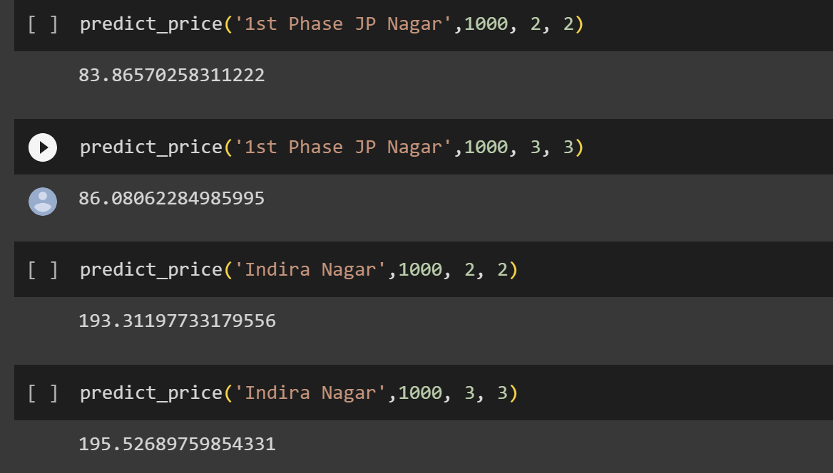
Results of Predicted values

Slide 11
Conclusion
In conclusion, the Real Estate Price Prediction project has successfully advanced the field of real estate analytics by creating accurate predictive models, providing valuable market insights, and automating the property valuation process. The research interests, encompassing advanced machine learning, and market analysis, have significantly contributed to the body of knowledge in this domain.
We believe that the outcomes of this research will foster informed decision-making, drive strategic investments, and promote data-driven policies, ultimately benefiting both professionals and consumers within the real estate industry.

Slide 12
Future Scope
The Real Estate Price Prediction project can be extended by exploring advanced machine learning models, ensemble methods, and time-series analysis. Incorporate external factors and geospatial data for comprehensive predictions.
Develop a user-friendly web application, leverage big data and cloud computing for scalability, and provide real-time market analysis.
Ensure model explain ability and address data privacy and ethical considerations. These advancements will enhance accuracy, usability, and applicability, making the project a valuable tool for real estate stakeholders and investors.

Slide 13
Reference
[1]. Aminah Md Yusof and Syuhaida Ismail ,Multiple Regressions in Analysing House Price Variations. IBIMA Publishing Communications of the IBIMA Vol. 2012 (2012), Article ID 383101, 9 pages DOI: 10.5171/2012.383101.
[2]. Babyak, M. A. What you see may not be what you get: A brief, nontechnical introduction to over fitting regression-type models. Psychosomatic Medicine, 66(3), 411-421.
[3]. Atharva chogle, priyanka khaire,Akshata gaud, Jinal Jain .House Price Forecasting using Data Mining Techniques International Journal of Advanced Research in Computer and Communication Engineering ISO 3297:2007 Certified Vol. 6, Issue 12, December 2017
[4]. Darshan Sangani,Kelby Erickson, and Mohammad Al Hasan, Predicting Zillow Estimation Error Using Linear Regression and Gradient Boosting, IEEE 14th International Conference on Mobile Ad Hoc and Sensor Systems (MASS), Page(s):530 - 534
[5]. Model,Azme Bin Khamis, Nur Khalidah Khalilah Binti Kamarudin ,Comparative Study On Estimate House Price Using Statistical And Neural Network, International journal of scientific and technology,research volume 3, ISSUE 12, December 2014,Page(s):126-131.

